Slide 1
Academic Integrity
Postgraduate Orientation
library@tcd.ie|www.tcd.ie/library|@tcdlibrary

Slide 2

Learning Outcomes
Following this session, you should be able to:
define ‘plagiarism’
understand the consequences of plagiarism & how it is detected
cite sources to avoid plagiarism
understand the role of reference management tools
Stock Photo: One bright light bulb among five identical light bulbs.
To represent idea: Original work creates; plagiarism copies.

Slide 3
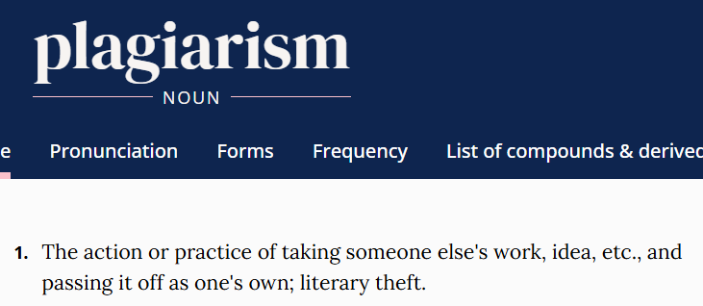
What is plagiarism?
Screenshot from digital version of Oxford English Dictionary showing definition of ‘plagiarism’.

Slide 4
Why refer to the work of others?
‘If I have seen further it is by standing on ye shoulders of Giants’ (Newton, 1676)
Papers on same subjects use similar terminology and draw on ideas and research that have gone before.

Slide 5
Acknowledging sources helps your readers
Credit your sources by citing them.
Allows readers of your work to:
find original sources
check you have adequately represented ideas of others
understand you are not trying to claim the ideas as your own.

Slide 6
Consequences of plagiarism in TCD
Detected plagiarism can carry severe consequences.
It is the act of plagiarism rather than the intent to deceive that will be punished.
If you are using somebody else’s words, images, music or ideas you must acknowledge (cite) the original source.

Slide 7
Paraphrasing
Including short paraphrases of others’ work is ok - it demonstrates processing/synthesis - but you must attribute the ideas to them.
If you use a long segment of paraphrasing, you are likely to lose marks on stylistic grounds.
It is not plagiarism if you have proper citations.

Slide 8
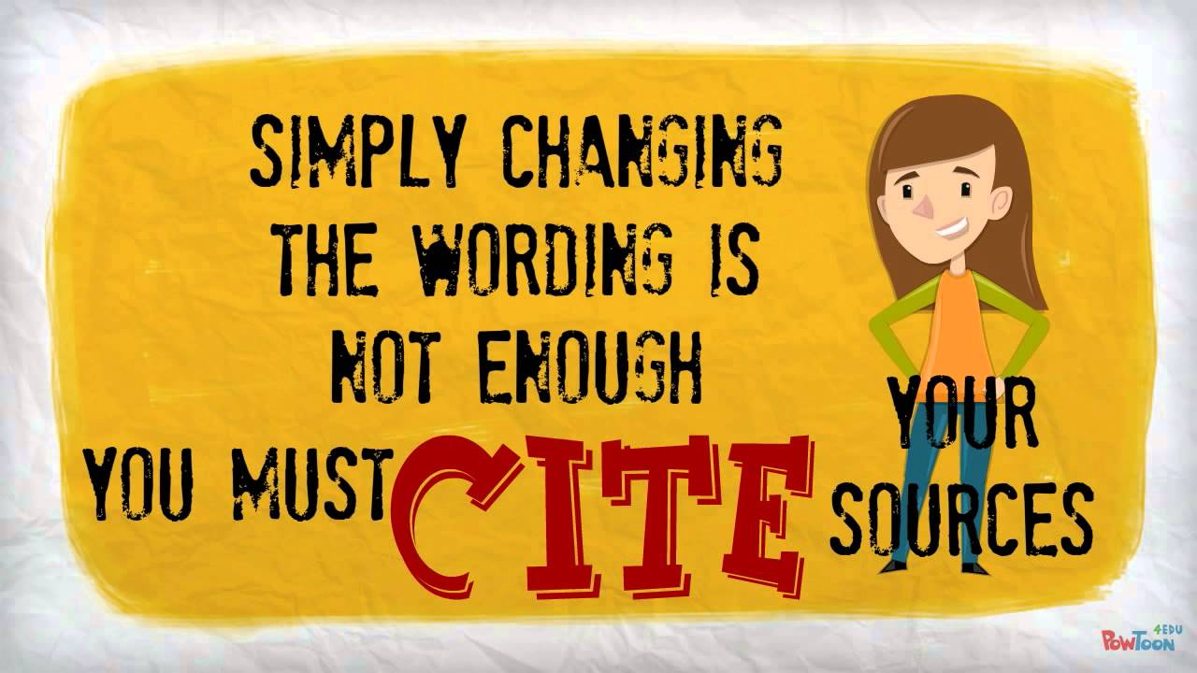
Copying from the Internet or AI…
“Copy and paste” is *very* easy to detect, but so is “Copy, shake and paste” – mixing up paragraph order, changing words etc. to make lifted sections appear different. And there are “tells” for use of AI!
Source: https://www.youtube.com/watch?v=LRODESfNzcc

Slide 9
Common knowledge: an exception
Citation is not needed for:
Facts, dates, events and information expected to be known by someone studying or working in a particular academic or professional field.
NO citation needed
vs
Citation needed
William Shakespeare wrote plays including Hamlet and Macbeth.
“Hamlet’s experiences could simply not have happened to a plumber.”
George Bernard Shaw

Slide 10
Quotes
Direct quotes of another’s words must be put into quotation marks and attributed.
Block quotes (longer quotes as a separate paragraph) should generally be used sparingly.

Slide 11
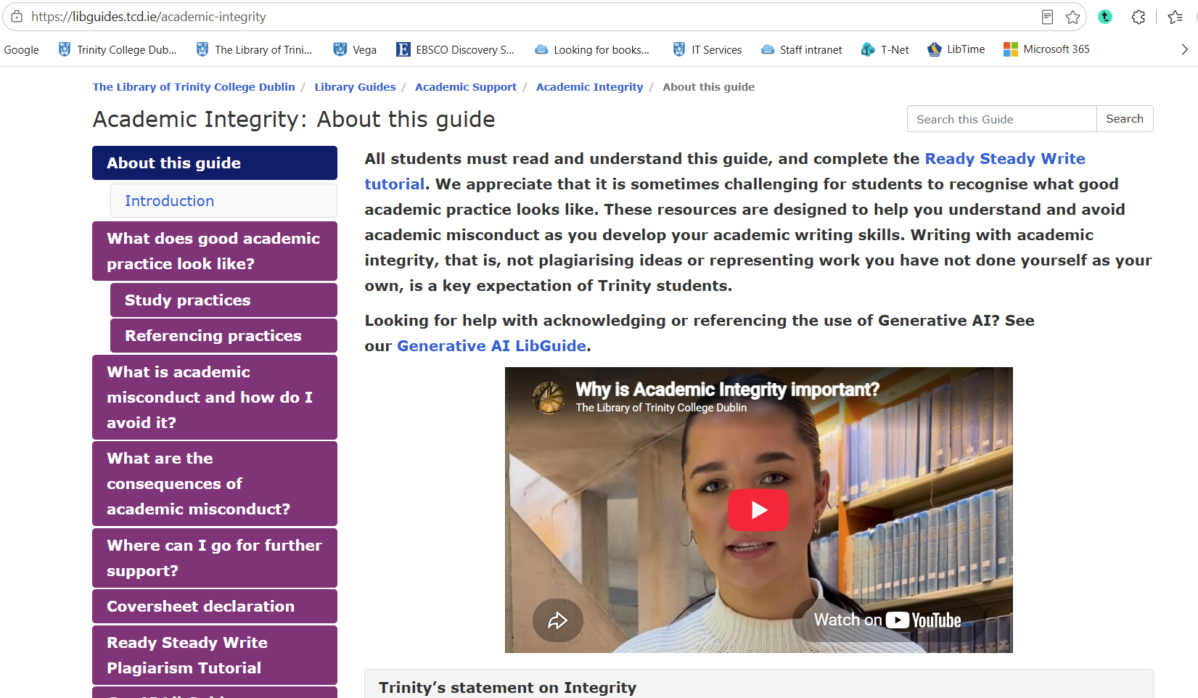
‘Ready Steady Write’ tutorial
Ready Steady Write is TCD’s plagiarism tutorial.
Sign a declaration when submitting course work, in hard or soft copy, or via Blackboard, confirming that you understand what plagiarism is and have completed the tutorial.

Slide 12

How is plagiarism detected?
Lecturers and examiners will be familiar with key sources.
They will notice differences in style, terminology and accuracy in an essay.
Turnitin compares submitted work to a database of websites, articles, books and student papers.

Slide 13
Turnitin similarity score
Similarity score is not a measure of plagiarism.
A high similarity score might be satisfactory as long as you have made sure to cite all your references.
You may have a low score but have been heavily paraphrasing other sources without citation.

Slide 14
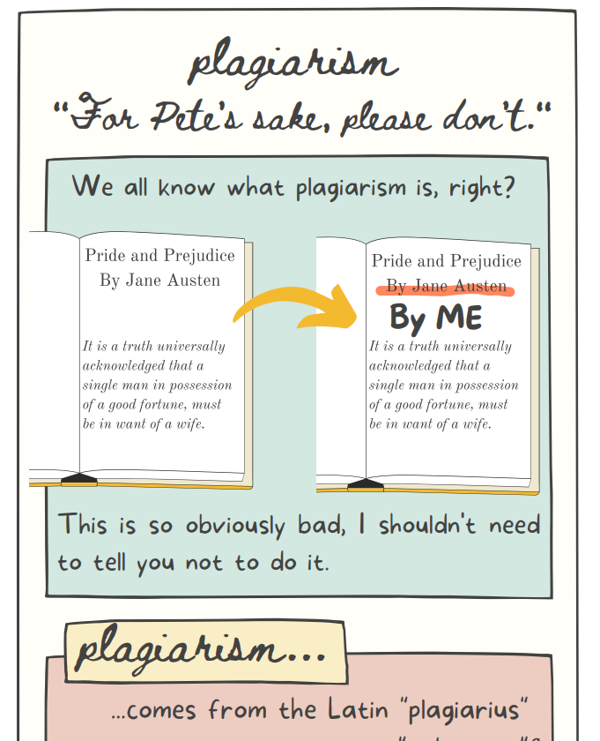
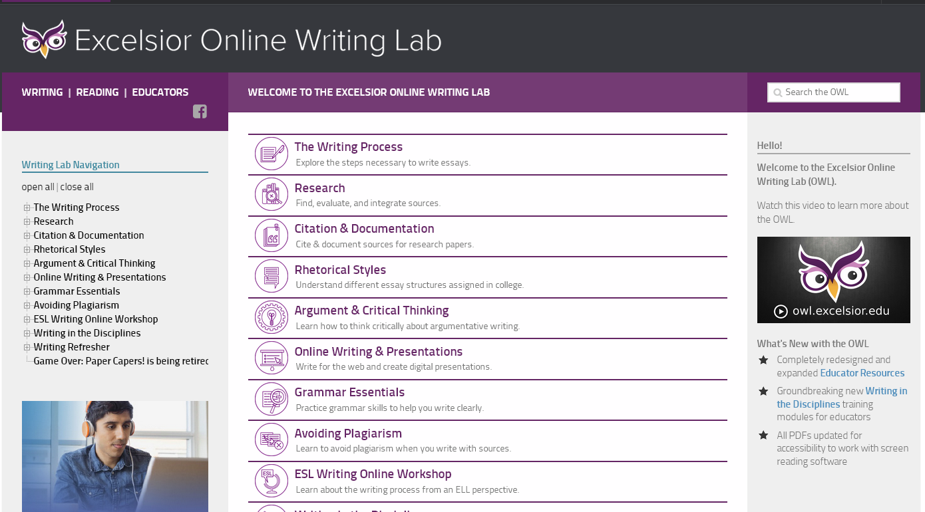
useful resources
Downloadable infographic by Emily Myers, University of Connecticut
How to Avoid Plagiarism video, Bainbridge State College
Excelsior Online Writing Lab

Slide 15
Over to You!

Slide 16
Quoting from your own work
Can you reuse parts of one of your own essays for a different class without citing the source?

Slide 17

Any questions?

Slide 18
Referencing Styles
(also called ‘Citation Styles’)

Slide 19

Which referencing style have you been told to use?
‘Harvard’
APA
Vancouver
Chicago
Irish Historical Studies
Any you like
Another
Don’t know

Slide 20
Citation styles
Guides for each style tell you:
how to format the references
which order to present the bibliographic information
how to use punctuation, capitalisation, italics, etc.
Different rules apply to different formats of sources (journal articles, books with one/several author(s), chapters in edited books, webpages, reports, films, YouTube videos, e-mails, etc.)

Slide 21

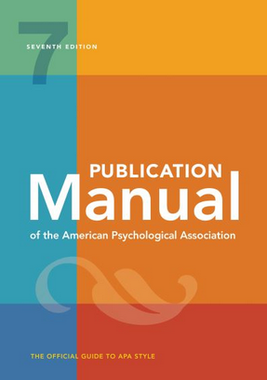
Style guides in tcd library
Boland Library
2nd Floor
LEN 150 L492*6;1
Ussher Library
1st Floor
REF 808 P34*6
Notes:
Image source: easons.com

Slide 22
Referencing/citation styles
Most are based on one of three broad types:
Parenthetical/Inline
Numbered
Footnotes
Your supervisor, course director or school/departmental administrator will advise if you should use a particular citation style.

Slide 23
Parenthetical/inline citations
First used at Harvard in the 1880s.
Enclose the partial information in brackets/parentheses.
Often referred to as Author-Date styles.
Not all use author-date, e.g. MLA uses author and page number.
Harvard

Slide 24
Parenthetical citations
Parenthetical citations use a brief summary of the reference in the text (such as listing the author and date, or the author and title, or author and page) with the full reference stated at the end of the chapter or work
This final list is called a reference list or bibliography (generally used interchangeably, although there are technically differences)
Usually, the full list of references will be in alphabetical order by the first author’s surname

Slide 25
Our Example
Reference Type: Journal Article
Author: McClimens, Alex; Kenyon, Lynn; and Cheung, Heidi
Year: 2013
Title: Exploring placement pathways in nurse education
Journal: British Journal of Nursing
Volume: 22
Issue: 1
Pages: 8-15
DOI: 10.12968/bjon.2013.22.1.8

Slide 26
Parenthetical style – APA 7th ed.
In the text:
…it’s clear that integrated care places new demands on students (McClimens et al., 2013)
Reference list:
McClimens, A., Kenyon, L., & Cheung, H. (2013). Exploring placement pathways in nurse education. British Journal of Nursing, 22(1), 8-15. https://doi.org/10.12968/bjon.2013.22.1.8

Slide 27
Numbered styles
Numbered styles list references in the order they are mentioned, using a digit in the text to refer to the fuller citation at the end
The most common numbered style is Vancouver - while this style has its own particular rules, numbered styles in general are often referred to as Vancouver styles
Other common styles used are IEEE, JAMA, and the Lancet

Slide 28
Numbered style – Vancouver
In the text:
…it’s clear that integrated care places new demands on students (1).
Reference list:
1. McClimens A, Kenyon L, Cheung H. Exploring placement pathways in nurse education. British Journal of Nursing. 2013;22(1):8-15.
Numbers are reused for the same reference!

Slide 29

footnoting styles
Like numbered styles, footnoting styles give the reference an ascending number in the text and the full references are listed in that order at the bottom of the page in a footnote.
A full list at the end of the work or chapter may also be required - although unlike with numbered styles, this will be in alphabetical order by surname, rather than in order of mention
The Chicago 18th Edition “Notes and Bibliography” style is the latest version of the best-known footnoting style

Slide 30
Footnote style: Chicago Footnote 18th ed.
In the text:
…it’s clear that integrated care places new demands on students¹
Footnote at bottom of page:
¹ Alex McClimens, Lynn Kenyon, and Heidi Cheung, "Exploring Placement Pathways in Nurse Education," British Journal of Nursing 22, no. 1 (2013), https://doi.org/10.12968/bjon.2013.22.1.8.
(Elements separated by commas.)
In reference list, in alphabetical order:
McClimens, Alex, Lynn Kenyon, and Heidi Cheung. "Exploring Placement Pathways in Nurse Education." British Journal of Nursing 22, no. 1 (2013): 8-15. https://doi.org/10.12968/bjon.2013.22.1.8.
(First author’s name inverted, elements separated by full stops.)

Slide 31
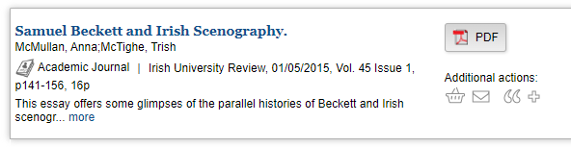
Referencing Journal articles
Anna McMullen and Trish McTighe, “Samuel Beckett and Irish Scenography”, Irish University Review 45, no. 1 (2015):https://doi.org/ 10.3366/iur.2015.0157
Referencing styles vary by School and subject.
Chicago-Style Citation Quick Guide

Slide 32
Have you used any reference management tools?
EndNote
Zotero
Mendeley
Sciwheel/Lean Library Workspace
Word’s built-in referencing
Another
None

Slide 33
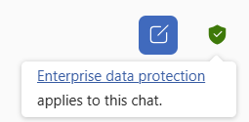
Gen AI
You can use Generative AI *unless you have been told not to by your School, Department, or lecturer*. They may state what use you can make of it, if any
HOWEVER, you need to acknowledge use of it, and *some* reference styles (like APA) mandate that you ALSO put the tool into the reference list
The Library has basic guidance on acknowledging and referencing using Generative AI on its website (link from the large image on the carousel)
Everyone at TCD has access to the corporate version of Microsoft Copilot (based on ChatGPT) – colloquially known as “ChatTCD”. This shouldn’t harvest your data, and won’t have as many limits as other free tools. Available when logged in with your Trinity account in Edge or at copilot.microsoft.com. Make sure you see the green tick so you know you are using the paid version!

Slide 34
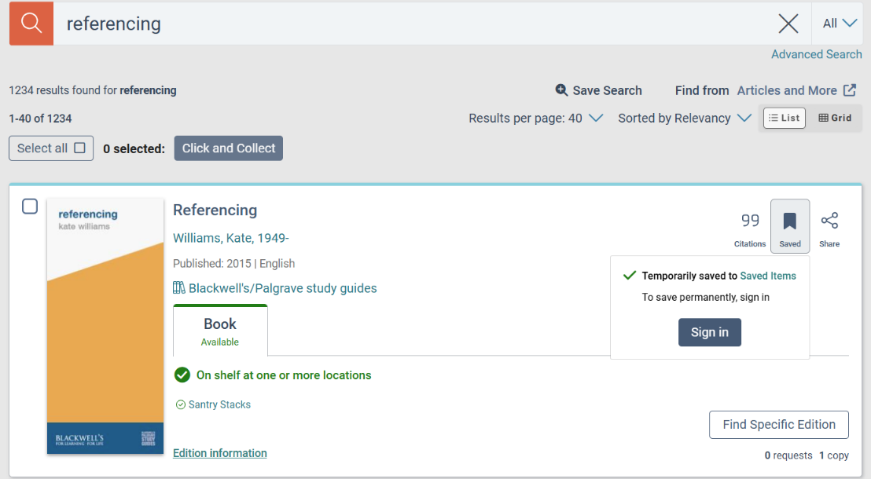
Maintain accurate records
Keep word-processed notes of sources.
Save searches or records in individual databases, e.g., JSTOR. First register / set up account.
Mark records in the library catalogue and save, export or e-mail results.
Use bibliographic/reference management tools (e.g. Endnote, Zotero).

Slide 35
Reference management tools
TCD Library supports you to use EndNote.
E.g. EndNote, Zotero, Mendeley
Import records from multiple databases and library catalogues, manually enter citations, and save all your references in one location.
Grab records and insert them into word-processing documents while you are writing (Cite While You Write in EndNote)
Look out for Library HITS session: Managing Your References

Slide 36

EndNote
A reference software tool for publishing and managing bibliographies.
Holds your references in one central library.
Desktop and Online versions.
http://www.tcd.ie/library/support/endnote

Slide 37
More information
Plagiarism:
start at https://libguides.tcd.ie/academic-integrity and complete the tutorial
e-mail your Subject Librarian
General referencing questions:
Excelsior Online Writing Lab (great resource for style guides)
e-mail your Subject Librarian
Choice of referencing style or Turnitin: ask your supervisor, course director or school/departmental administrator
EndNote: Library Subject Librarian team
Academic writing: Academic Writing Centre TCD
Notes:
Simplify and update? Eg no duty desk???

Slide 38
Where to get help
Subject Librarian: hbradle@tcd.ie
General Enquiries: library@tcd.ie
Library website: www.tcd.ie/library
Online tutorials: Guides & Tutorials - The Library of Trinity College Dublin - Trinity College Dublin (tcd.ie)
Library HITS (Helpful Information for Trinity Students/Staff): Library Training Sessions - The Library of Trinity College Dublin - Trinity College Dublin (tcd.ie)
  Counter Service: all Libraries
  Duty Librarian Desk: Eavan Boland Library (Iveagh Hall / ground floor)
  Video Guides: The Library of Trinity College Dublin YouTube Channel; ‘Getting to know the Library’ playlist

Slide 39
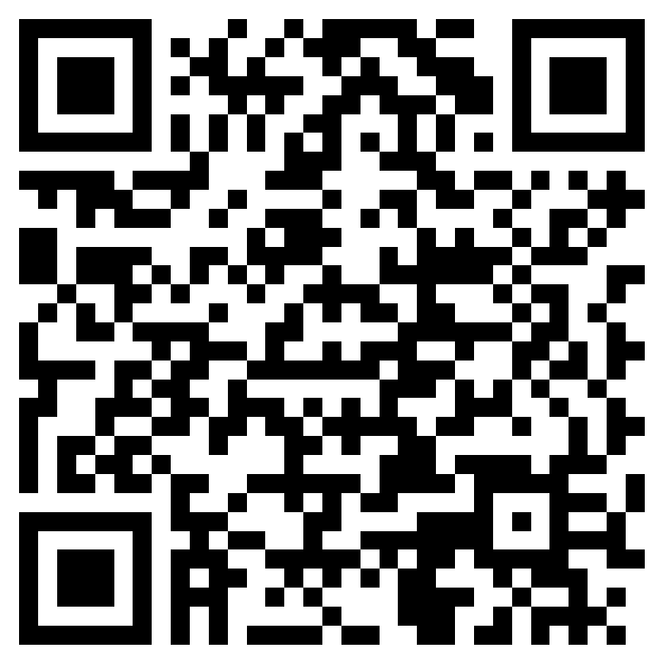
Please give feedback
Your comments and ideas help us to focus on more things you would like to learn about.
Take our 2-min. survey.
Thank you so much!

